Slide 1
Ruckus Access Points

Slide 2
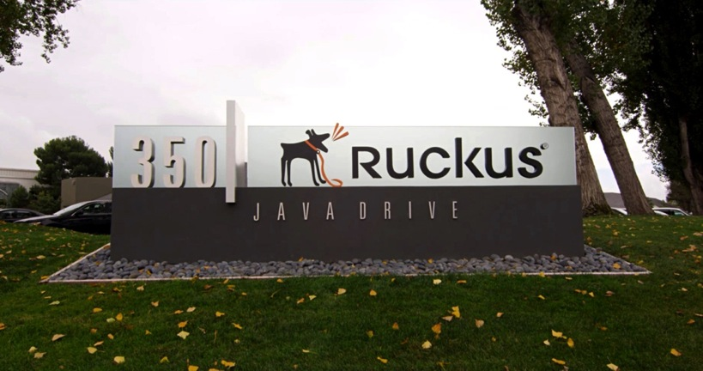
Fast and Fierce
Formed
2004
Customers
61,000+
Countries
196
Patents
100+ Granted
Sunnyvale, CA
Notes:
Headquartered in Sunnyvale, CA, Ruckus Wireless was incorporated in 2004 and now has offices worldwide.
After 11 years, Ruckus is now a truly global company with over 56K customers in 196 countries and has had over 100 patents granted over the same time period.

Slide 3

Who’s Ruckus
IDC MarketScape: Enterprise WLAN Market
2016
MarketScape Report
Participants
Contenders
Major Players
Leaders
Cisco
Aruba
“
HP
RUCKUS
Ruckus has a strong history of
internal innovation, from
pioneering wireless IPTV transport technology to various advances in antenna technology, including being
an industry pioneering of adaptive antenna arrays and many other advanced RF functionalities. The company continues to add to and
redefine its value proposition.
Motorola
Aerohive
Meru
Juniper
Xirus
Enterasys
ADTAN
Capabilities
Ubiquiti
D-Link
Extricom
”
Strategies
Notes:
Customer accolades are backed by industry analysts.
IDC’s MarketScape for the WLAN vendor market underscores the fact that Ruckus is one of few WLAN vendors in the top leadership quadrant for the enterprise WLAN market.
Most importantly, IDC hails Ruckus’ strength in RF and antenna technologies – clearly the most important component for reliable, high performing, wireless connectivity.

Slide 4
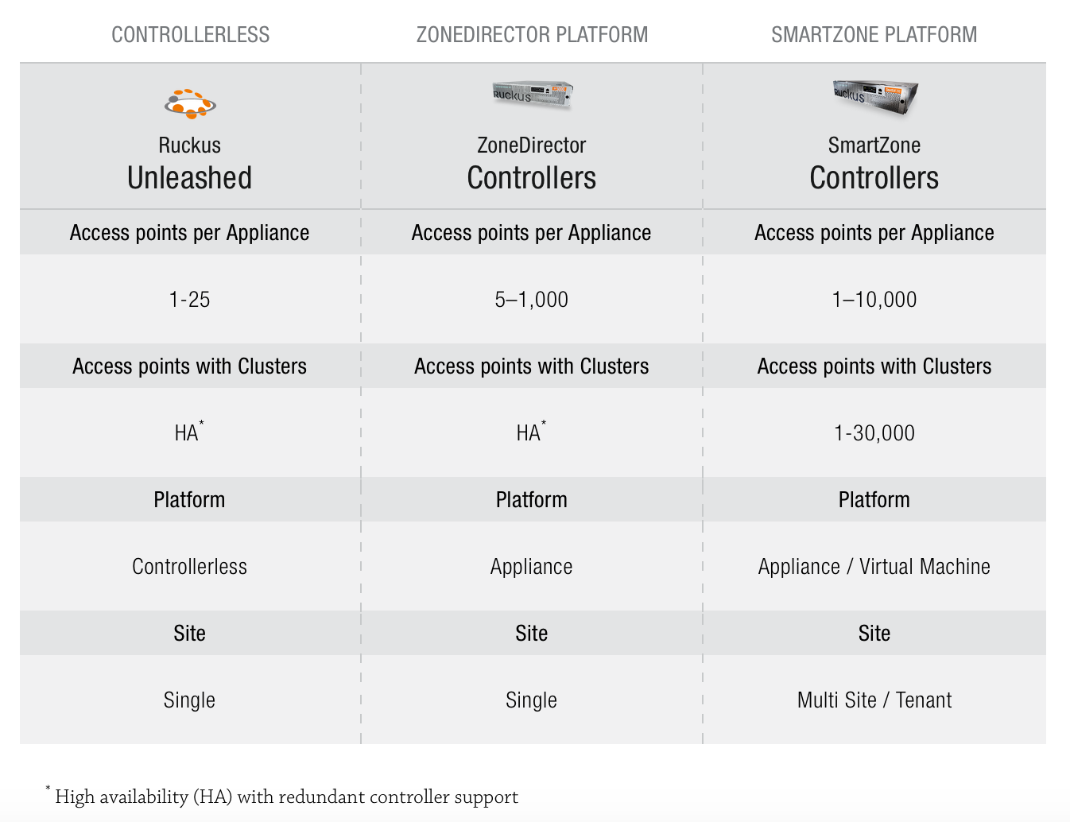
The Right Platform for Your Needs
Multiple backhaul technologies
Indoor and outdoor access points
On-premise and cloud controllers
Progressive scalability
Tunneling options
Notes:
Ruckus offers the right platform for your needs, which includes multiple backhaul technologies delivering management to a plethora of indoor and outdoor AP to suit any need.
The management platforms include either on premise hardware or virtual or cloud platforms.

Slide 5
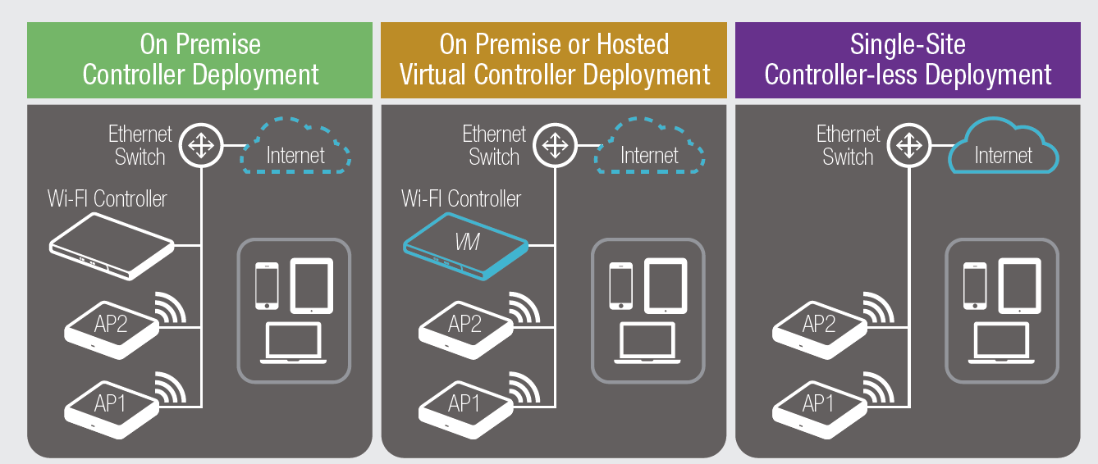

Flexible Deployment Options
Notes:
Standalone or centrally-managed APs
Mesh or hardwire mesh APs
Option for centralized or remote controllers
Remote Wi-Fi management over WAN
Seamless integration with security services
Distributed controller-less data flow for APs

Slide 6
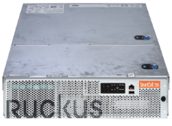
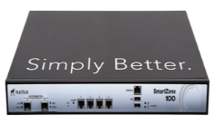
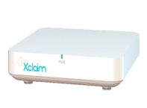

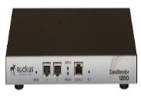
Solution Positioning
Very Large
Medium to Large
Small
Small to Medium
Very Small
SZ 100
SCG-200
Max APs:
Clients:
Capacity:
Size:
1,024
25,000
10 Gbps
1RU
Max APs:
Clients:
Capacity:
Size:
10,000
100,000
20 Gbps
2RU
Xclaim
Unleashed
ZD 1200
Cloud-based
Highest simplicity
Lowest cost
Less performance
Less control
Less support
Max APs:
Clients:
Capacity:
Size:
25
512
No Tunnel
Controller-less
Max APs:
Clients:
Capacity:
Size:
75
2000
200 Mbps
Mini Desktop
Max APs:
Clients:
Capacity:
3+1 Cluster
3+1 Cluster
3,000
60,000
30 Gbps
Max APs:
Clients:
Capacity:
30,000
300,000
60 Gbps
Deployment Type
SMB Single-site
SMB Campus
SMB Multi-site
Medium to Large Campus
Enterprise Distributed Sites
SP Internal Network
Managed Services
ZD 3K & 5K continue to be available with new feature releases

